Slide 1
BLOCK L: Designing with Light Alloys
Light Alloys Presentation 2
STRUCTURE - PROPERTIES - PROCESSING

Slide 2
Structure – Properties - Processing
Having selected a material or materials as with the case study we need to examine in detail the materials properties not only meet the design but also how the material may be processed and how the processing influences the the material properties and the design.
There are many Al alloys - we will discuss later.
However, Al-Si alloys have many advantages for an engine piston….

Slide 3
Advantages of Al-Si alloy for a piston
Material | ρ/gcm⁻³ | α/K⁻¹ | Vickers Hardness Hv
Aluminium | 2.67 | 23.5 x 10⁻⁶ | 870-1350
Silicon | 2.33 | 9.6 x 10⁻⁶ | 170
Lower density Si means alloy has a lower density, helps with strength to weight.
Si has a large solubility range in Al so potential for solid solution strengthening and precipitation hardening, improving strength and creep resistance.
Si lower thermal expansion coefficient means the alloy a has a lower thermal expansion coefficient than Al.
Improved hardness of alloy reduces piston wear
Now we need to explore the structure- properties-processing interaction…

Slide 4
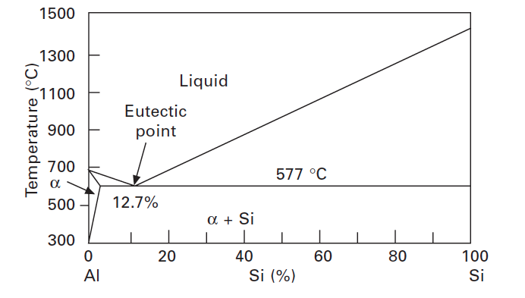
Structure - Properties - Processing
Micrsotructure
Al-Si alloys easily cast
Notes:
Discuss eutectic for castability lowest L T and
despite better fatique resistance for the hypereutectic if too much Si then melt T too high
Change this diagram…1.65 % solubility max

Slide 5
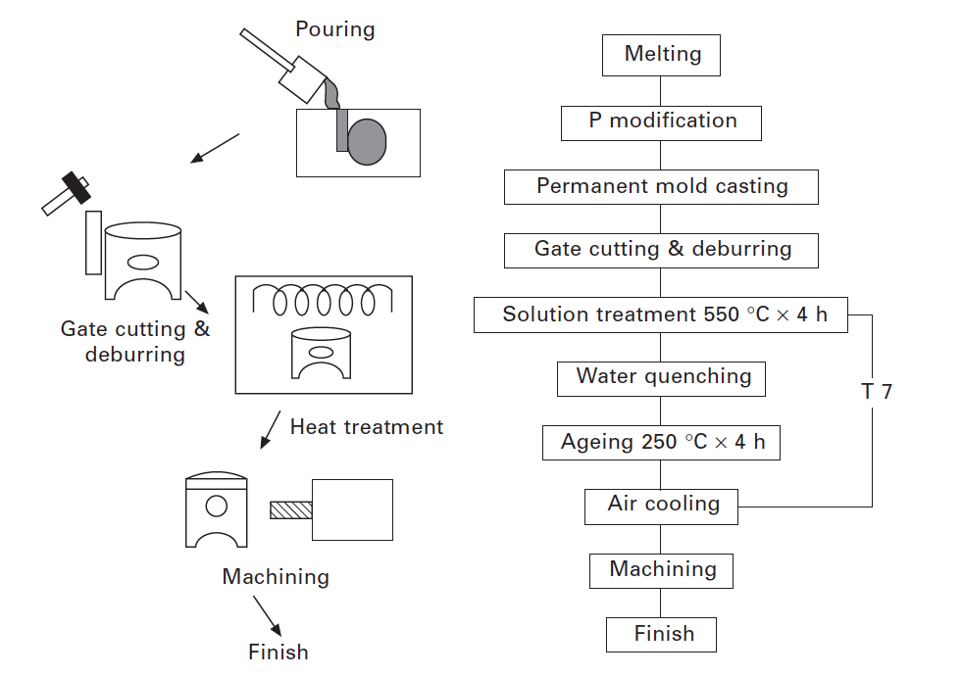
Structure - Properties - Processing
CASTING LINK
Notes:
Remind from MM1IMF Command dicsuss what we mean by T6 and T7 later

Slide 6
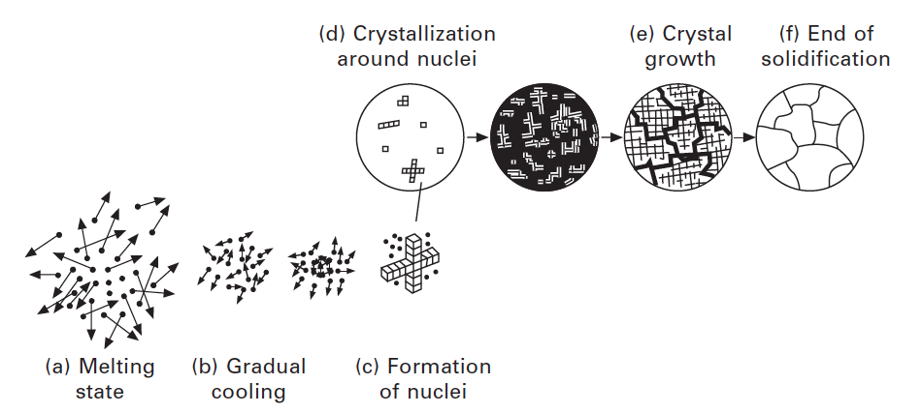
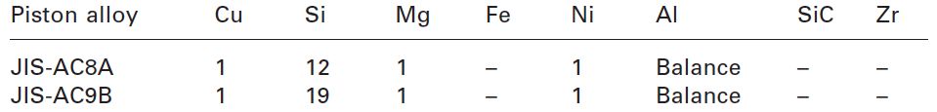
Structure - Properties - Processing
Two typical Al-Si alloys used for pistons with 12 and 19 wt% Si
Why 12 and 19 wt% Si?
The role of the additions, Cu, Mg and Ni?
Other additions e.g. P, Sr, Na ?
Can we use Age Hardening?

Slide 7
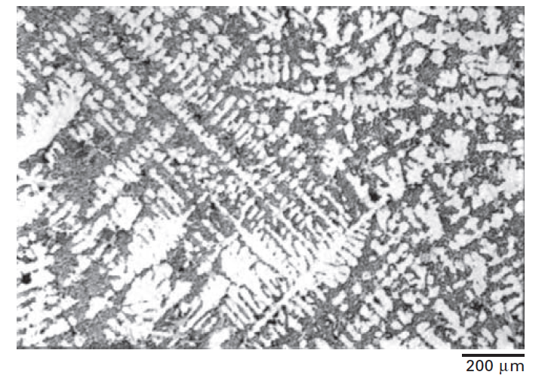
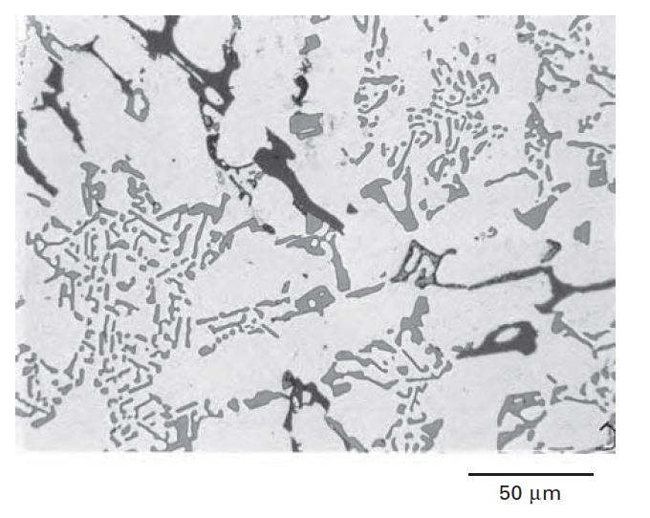
Structure - Properties - Processing
With 12wt% Si – close to eutectic composition so get eutectic Si ( grey areas) formed in between the eutectic α (Al rich phase – white areas) ).
It can be melted at low temperature, therefore easily castable
( Note the black areas are Al₂Cu from the Cu in the alloy…more on that later)

Slide 8
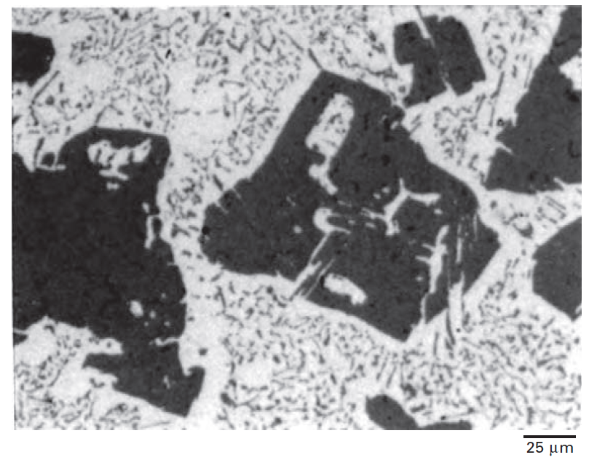
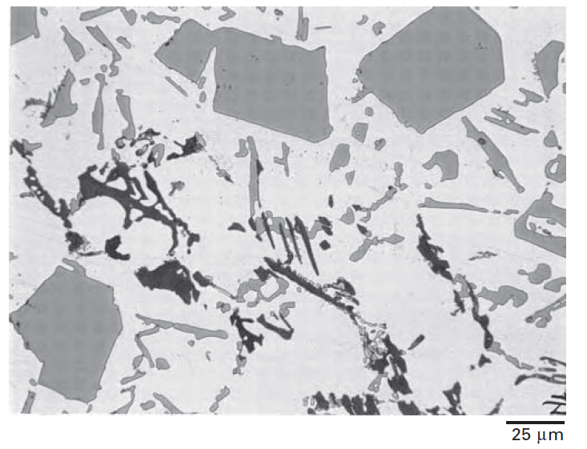
Structure - Properties - Processing
Al-19wt%Si alloy without P Al-19wt%Siwith P
With 19wt% Si – then alloy has even lower density improving strength to weight ratio. Also the primary silicon that forms helps strength the alloy and improve its hardness. Ideal for the piston grooves for the rings….but it becomes susceptible to brittle failure…so..
The strength and the fracture toughness is improved by reducing the grain of primary Si formed thus need to encourage nucleation of the primary silicon. To do this small amounts of P are added into the melt
Notes:
Get rid and talk about fracture toughness, nucleating large voids with large

Slide 9
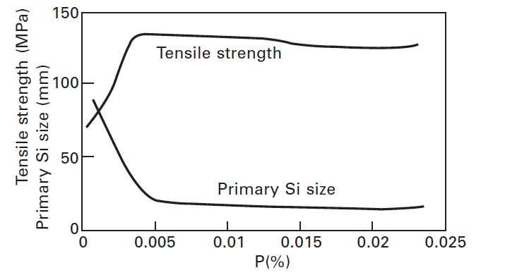
Structure - Properties - Processing
Note only small amounts of P are required
ALSO Strontium or Sodium is added to produce a rod like eutectic structure rather than a plate like structure improving fracture toughness more
Notes:
Strontium or NA
added to refine the eutectic to produce rod like eutectic rather than the plate like structure

Slide 10
Age Hardening - Al alloy systems are suitable
Structure - Properties - Processing
Form a monophase solid solution at high temperatures
Reject a finely dispersed precipitate during aging, i.e. The phase diagram must show a declining solvus line.
Al-rich end of Al-Cu system,
Al-rich end of Al-Li system
Notes:
Each alloy system is different but general characteristics which give suitable systems for pptn hardning are :
Form a monophase solid solution at high temperatures
Reject a finely dispersed precipitate during aging, i.e. The phase diagram must show a declining solvus line.
If the look confused explain: Solvus line is the locus of points representing the limit of solid solubility as a function of temperature.
Click Left hand figure shows the Al-rich end of the Al-Cu system whilst the right hand side shows the phase diagram of the Al-Li system. Lithium is interesting in that its addition to aluminium results in the lowering of density as well as a substantial increase in the modulus of the alloy.
B

Slide 11
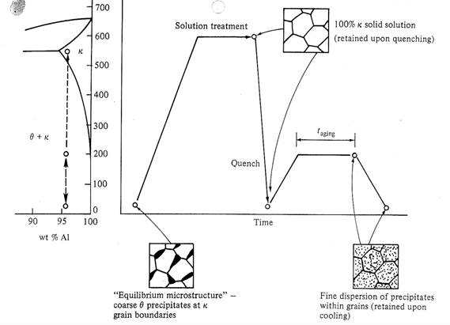
Structure - Properties - Processing
Solution, treating, quenching and aging

Slide 12
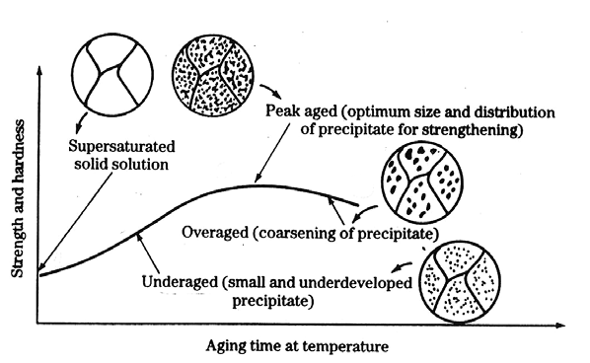
Structure - Properties - Processing

Slide 13
Coherency and incoherency
……this is useful concept o explain strengthening in precipitation alloys
Different crystallographic relationships between matrix and second phase.
(a) Complete coherency.
(b) Coherency with strained, but continuous, lattice planes across the boundary.
(c) Semicoherent, partial continuity of lattice planes
across the interface.
(d) Incoherent equilibrium
precipitate, no continuity of
lattice planes across the interface.
a
b
c
d
Notes:
In the initial stages of the aging treatment, zones that are coherent with the matrix appear. These zones are nothing but clusters of solute atoms on certain crystallographic planes of the matrix. In the case of Al-cu, the zones are a clustering of copper atoms on the [100] planes of aluminium. The zones are referred to a Guinier-Preston zones, or GP zones, in honour of the two researchers who discovered them.
They are called zones rather than ppts in order to emphasize the fact that the zones represent a small clustering of solute atoms that has not yet taken the form of precipitate particles. The GP zones are very small and have a very small lattice mismatch with the aluminium matrix. Thus they are coherent with the matrix i.e. The lattice planes cross the interface in a continuous manner. Such coherent interfaces have very low energies but there are small elastic coherency strains in the matrix. As these coherency strains grow, the elastic energy associated with them is reduced by the formation of semicoherent zones where dislns form at the interface to take up the misfit strain. Further growth of the of the semicoherent zones, or ppts, results in a complete loss of coherency: an incoherent interface forms between the ppt and the matrix.
So the nature of ppt/matrix interface produced during the aging treatment can be coherent, semicoherent, or incoherent.
Coherency signifies that there exists a one-to-one correspondence between the ppt lattice and that of the matrix. Fig (a) and (b).
A semicoherent ptt signifies only partial correspondance between the two sets of lattice planes.

Slide 14
Structure - Properties - Processing
The hardening mechanism is complex during the aging process.
For example in the Al-Cu system :
Initially solid solution hardening occurs. The Cu trapped in solid solution in the supersaturated α phase
Then all the solute disappears from solution and disk shaped Guinier –Preston (GP) zones form. These GP disk faces ( ~ 10 nm across) are coherent with the matrix but the edges have a large coherency strain.
GP zones extend by diffusion and form θ” precipitates. Disc faces ( now ~ 100 nm across) are coherent but again the edges have high coherency strain due to mismatch between the θ” phase and the matrix.
This coherency strain due to GP zones and θ” cause the largest precipitation hardening effect by restricting dislocation movement

Slide 15
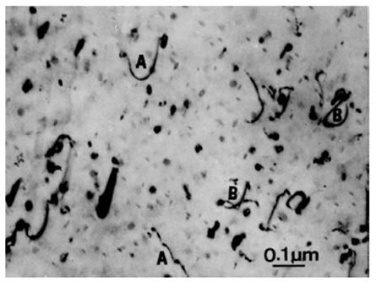
Structure - Properties - Processing
θ” precipitates dissolves with the Cu diffusing further and forming an θ’ phase. The discs ( now ~ 1 μm across) have edges that are incoherent.
Finally at the edges of the θ’ – matrix and grain boundaries equilibrium θ ( Cu₂Al) nucleates and grow as the θ’ precipitates dissolve . These more rounded precipitates are completely incoherent with matrix.
Their effectiveness in in stopping dislocations limited because the dislocations can either cut through them or bow between them

Slide 16
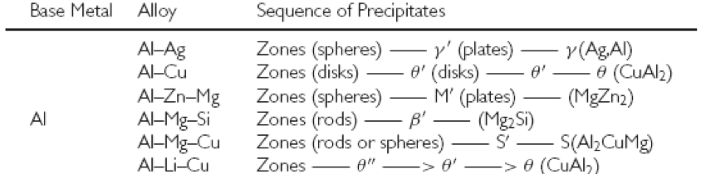
Structure - Properties - Processing
Therefore intermediate metastable phases are very important for effective Age Hardening. This is also true in other combinations with ….
So with the piston alloy the additions of Mg and Cu allow effective Age Hardening with Zones, S’ and θ” precipitates being effective.
Notes:
SECONDARY EFFECT AND REDUCE SLIDES

Slide 17
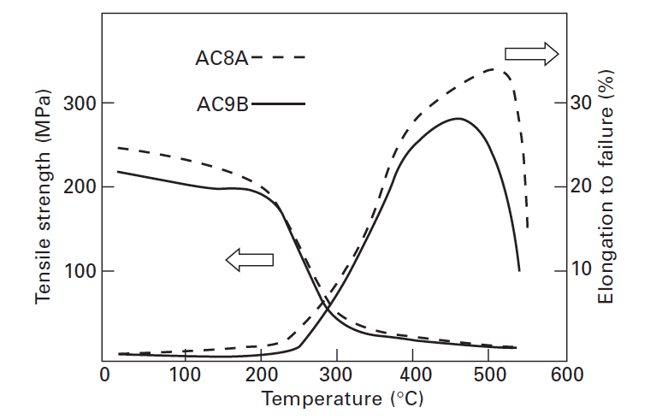
Structure - Properties - Processing
Top of piston can reach 350 ˚C
This can cause a problem…

Slide 18
Structure - Properties - Processing
Small amounts of intermetallic elements such as Fe, Cr or Ni then can form intermetallic compounds - strengthen the alloy at higher temperatures.
Intermetallics - too much forms a coarse brittle structure also heavier elements add to weight of alloy.
For this case study example 1 wt% Ni has been added which then forms Al₃Ni in the structure which strengthens it at higher Temperature.

Slide 19
Structure - Properties - Processing
Additional constraints: High performance - lightweight
Cast Al-Si is cost effective and ideal for mass production. However casting can produce defects which limits the strength and the thick sections of the casting cool slower with a coarser and therefore weaker microstructure.
ALTERNATIVE PROCESSING
Forging
Powder metallurgy

Slide 20
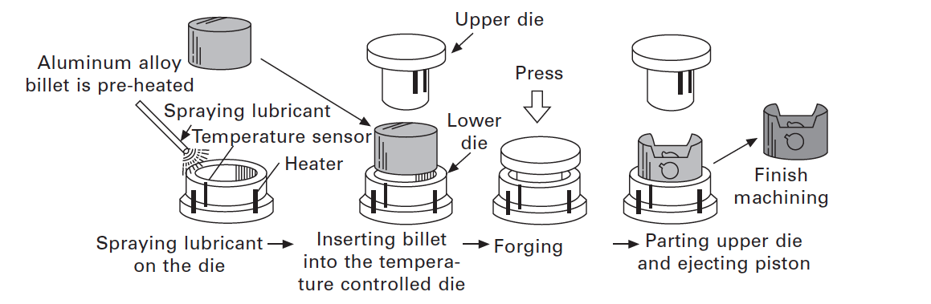
Structure - Properties - Processing
Forging
This is limited by the ductility (elongation) of the alloy thus forged components are rarely near net shape but require a finishing step
FORGING LINK

Slide 21
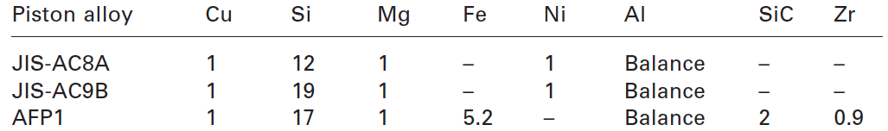

Structure - Properties - Processing
Powder Metallurgy (PM)
Molten alloy sprayed into powders
high cooling rate 10³ K s⁻¹.
Rapidly cooled alloy includes finely dispersed intermetallics.
Powder is mixed with SiC powder to improve wear resistance.
Powders cold compacted in a die - green cylinder compacts.
These are then sintered followed by hot forging.
A typical PM alloy composition used for piston is:
GAS ATOMISATION LINK
PM Link 1
PM Link 2
Notes:
FeAl intermetallic

Slide 22
Structure - Properties - Processing
Reinforcement of the piston ring grove
Wear on the piston ring grove can be a serious problem effecting power efficiency and increasing oil consumption.
Si and SiC can be added to improve wear resistance.
However more can be done:
Anodisation to produce a hard wear resistance oxide layer
Insert a wear resistant material:
  Cast iron with high hardness and reasonable thermal expansion (problem - heavy)
  fibres of Alumina ( Al₂O₃) and silica (SiO₂) in a preform in which the Al alloy is squeeze cast (light)
Notes:
To add Fatique behaviour – resiustant to fatigue….fatigue data in CES
Fatique behaviour ---- see Paul about total cycles
Cyclic pressure in combiution

